Slide 1

How fair is access to more prestigious UK universities?
Vikki Boliver
CRESJ seminar, University of York
12th June 2012

Slide 2
Background to the study
Expansion and growing differentiation of UK HE means we need to ask not only “who goes to university?” but also “where do they go?”
Particularly important to examine access to prestigious universities because already substantial variation in the returns to HE, and probably soon to be substantial variation in the cost of participation
Official discourse is one of ’fair access’…
  “When we talk about ‘fair access’, we mean removing the barriers to higher education, particularly financial barriers, that students from lower income and other under-represented backgrounds face.” (www.offa.org.uk)

Slide 3
Research questions
To what extent can access to more prestigious UK universities be said to be ‘fair’, at least in the limited sense of access determined by prior attainment alone?
What role is played by the application choices made by prospective students on the one hand, and by the admissions decisions made by universities on the other?
How, if at all, has fair access to more prestigious UK universities been affected by the introduction and increase of tuition fees in 1998 and 2006?

Slide 4
Data and methods
Individual-level data from the Universities and Colleges Admissions Service (UCAS) for the period 1996-2006
  Random sample of 2.5% of all ‘home’ applicants living in England in each even year
  N = 49,162 applicants making 228,441 applications
Focus on social class, school background, and ethnic origin inequalities in the odds of application and admission to Russell Group universities
Aim is to see whether these inequalities can be accounted for by social group differences in prior attainment

Slide 5
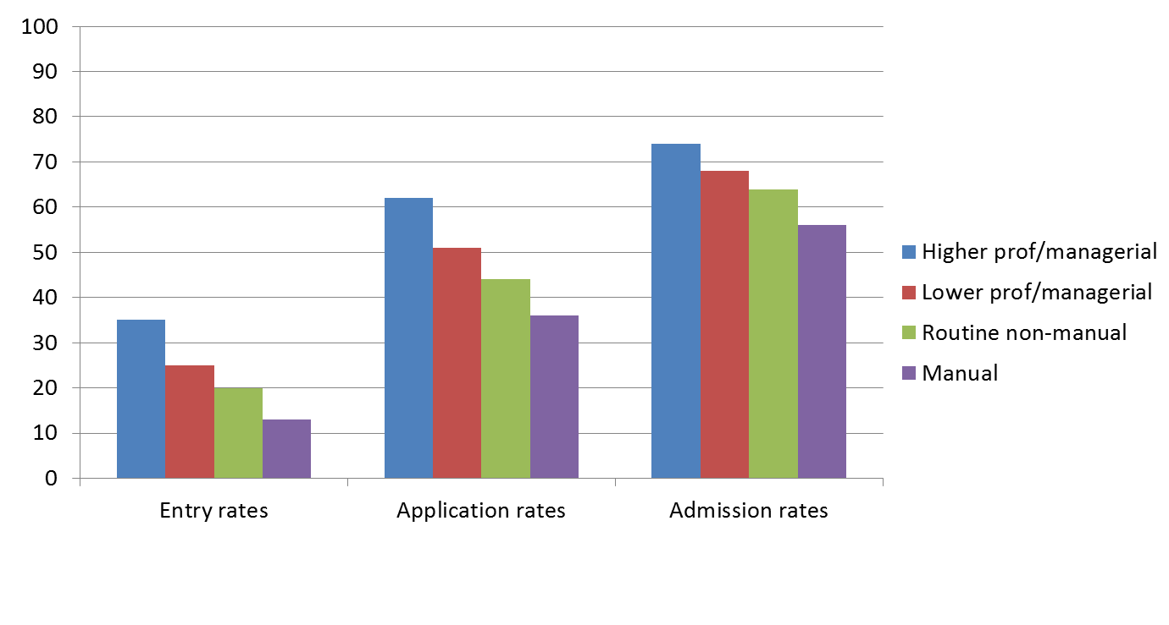
Social class inequalities
Rates of entry, application and admission to RG universities

Slide 6
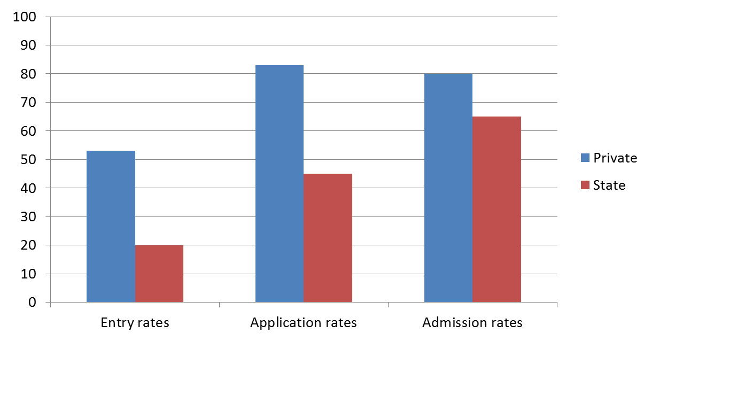
School background inequalities
Rates of entry, application and admission to RG universities

Slide 7
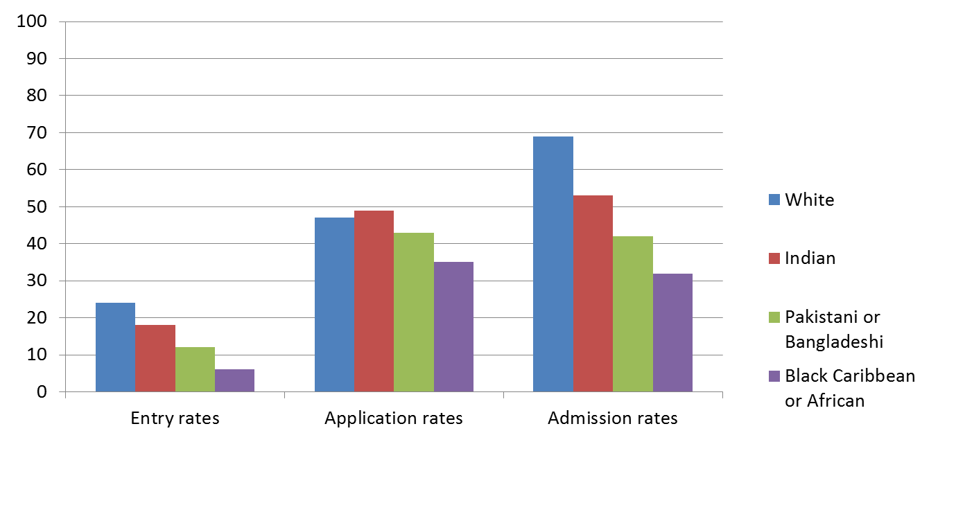
Ethnic group inequalities
Rates of entry, application and admission to RG universities

Slide 8
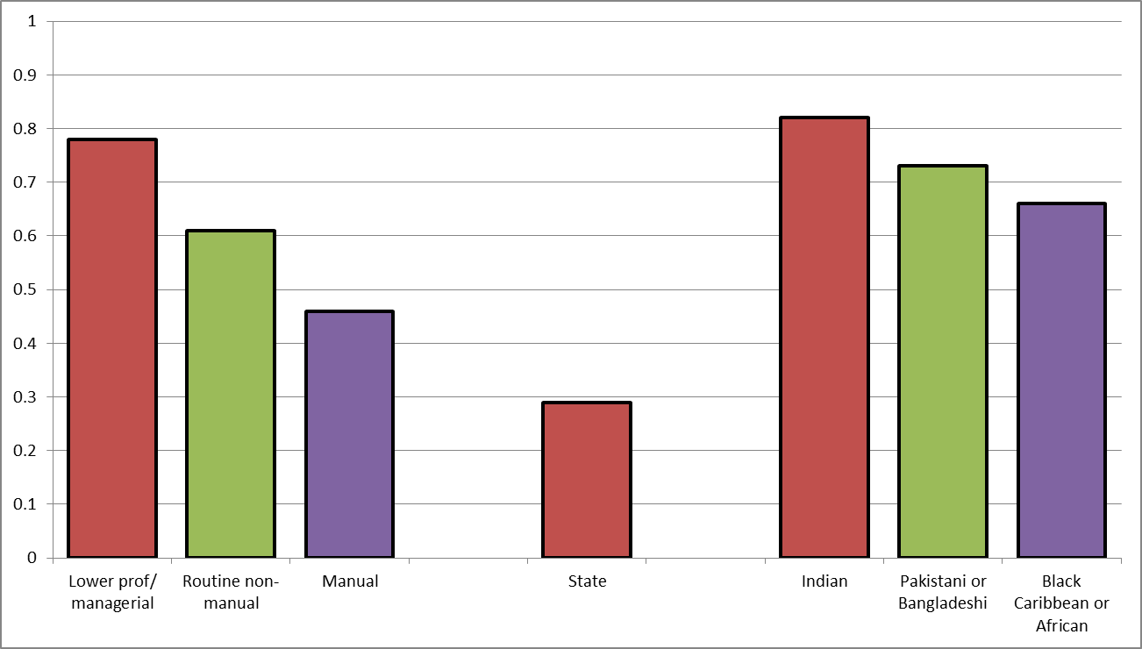
Application
Model 1 Social inequalities before taking into account prior attainment
Odds ratios: application to a Russell Group university
Model 1 includes controls for sex, mature student status, HE subject area, HE qualification aim, and application year.

Slide 9
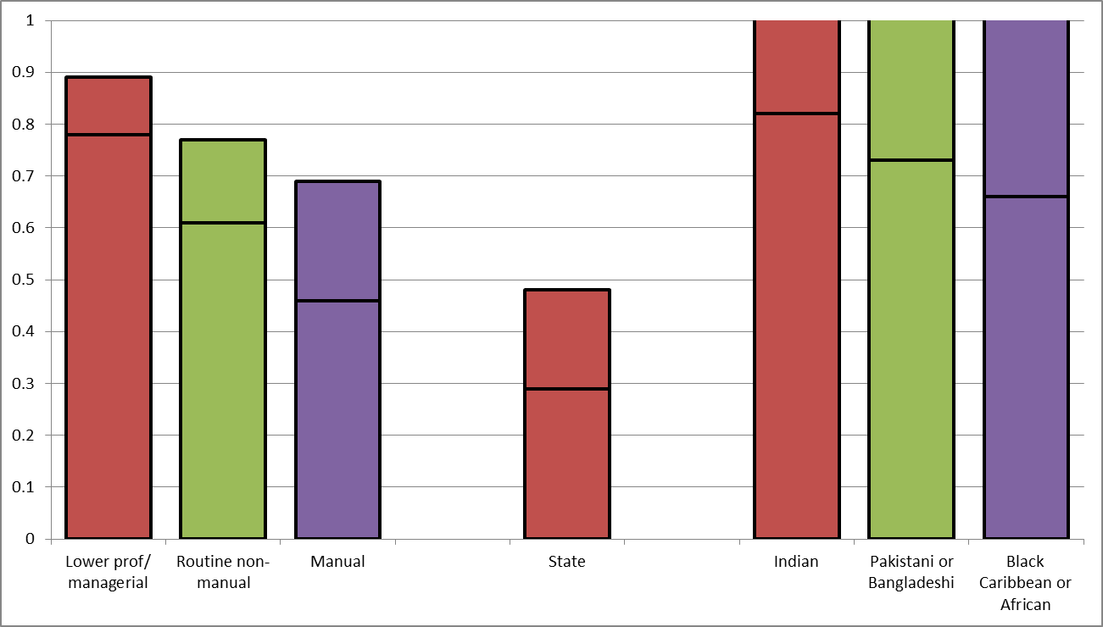
Application
Model 2 Social inequalities after taking into account prior attainment
Odds ratios: application to a Russell Group university
Model 2 includes controls for sex, mature student status, HE subject area, HE qualification aim, application year, A-level applicant or not, and A-level point score.

Slide 10
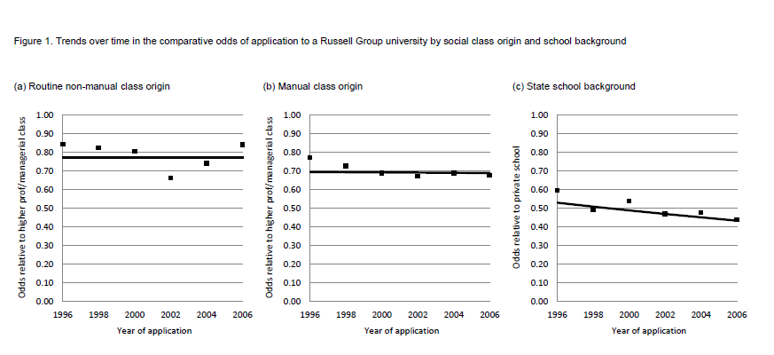
Application
Model 3 Change over time?
Model 3 as Model 2 plus interactions with application year.

Slide 11
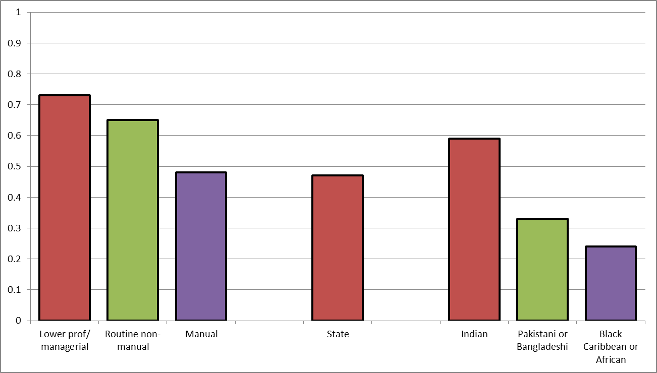
Admission
Model 1 Social inequalities before taking into account prior attainment
Odds ratios: offer of admission from a Russell Group university
Model 1 includes controls for sex, mature student status, HE subject area, HE qualification aim, HEI applied to (anonymized) and application year.

Slide 12
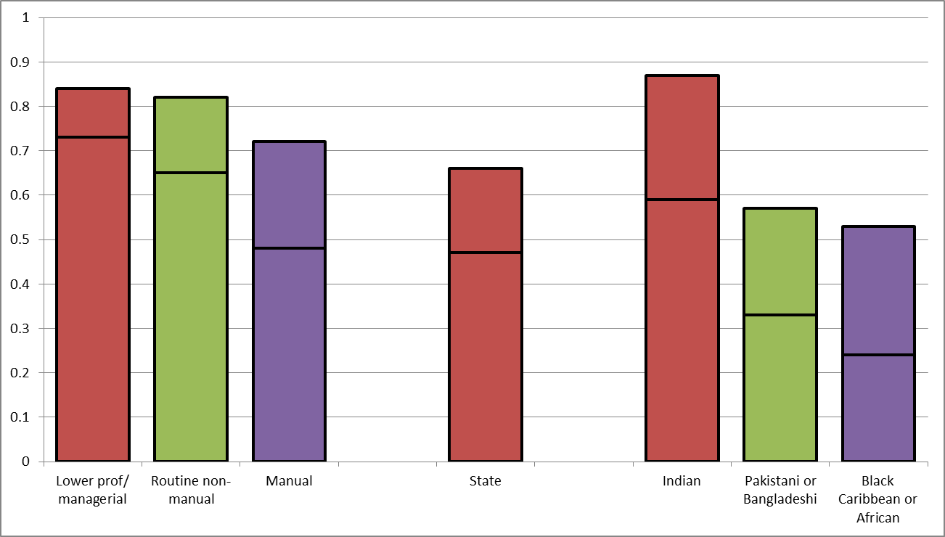
Admission
Model 2 Social inequalities after taking into account prior attainment
Odds ratios: offer of admission from a Russell Group university
Model 2 includes controls for sex, mature student status, HE subject area, HE qualification aim, HEI applied to (anonymized), application year, A-level applicant or not, and A-level point score.

Slide 13
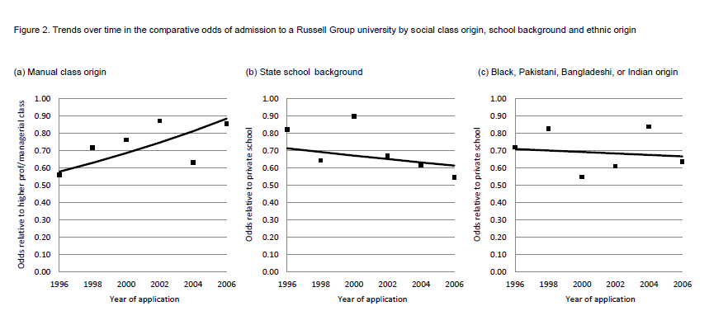
Admission
Model 3 Change over time?
Model 3 as Model 2 plus interactions with application year.

Slide 14
Application
Model 2 Social inequalities after taking into account prior attainment
Odds ratios: application to a Russell Group university
Model 2 includes controls for sex, mature student status, HE subject area, HE qualification aim, application year, A-level applicant or not, and A-level point score.

Slide 15
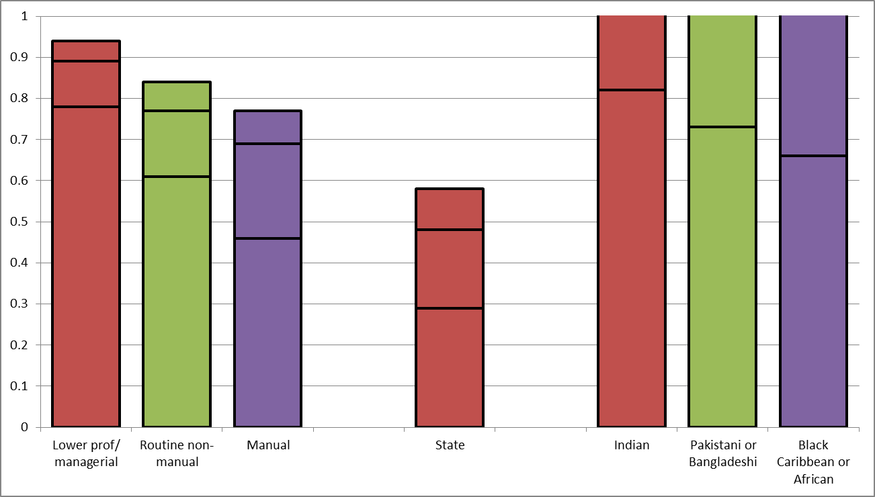
Application
Model 4 A-level applicants only, specific grades and ‘facilitating subjects’
Odds ratios: application to a Russell Group university
Model 4 includes controls for sex, mature student status, HE subject area, HE qualification aim, application year, A-level grades and ‘facilitating subjects’ at A-level.
Notes:
2 classes and 2 school types still sig

Slide 16
Admission
Model 2 Social inequalities after taking into account prior attainment
Odds ratios: offer of admission from a Russell Group university
Model 2 includes controls for sex, mature student status, HE subject area, HE qualification aim, HEI applied to (anonymized), application year, A-level applicant or not, and A-level point score.

Slide 17
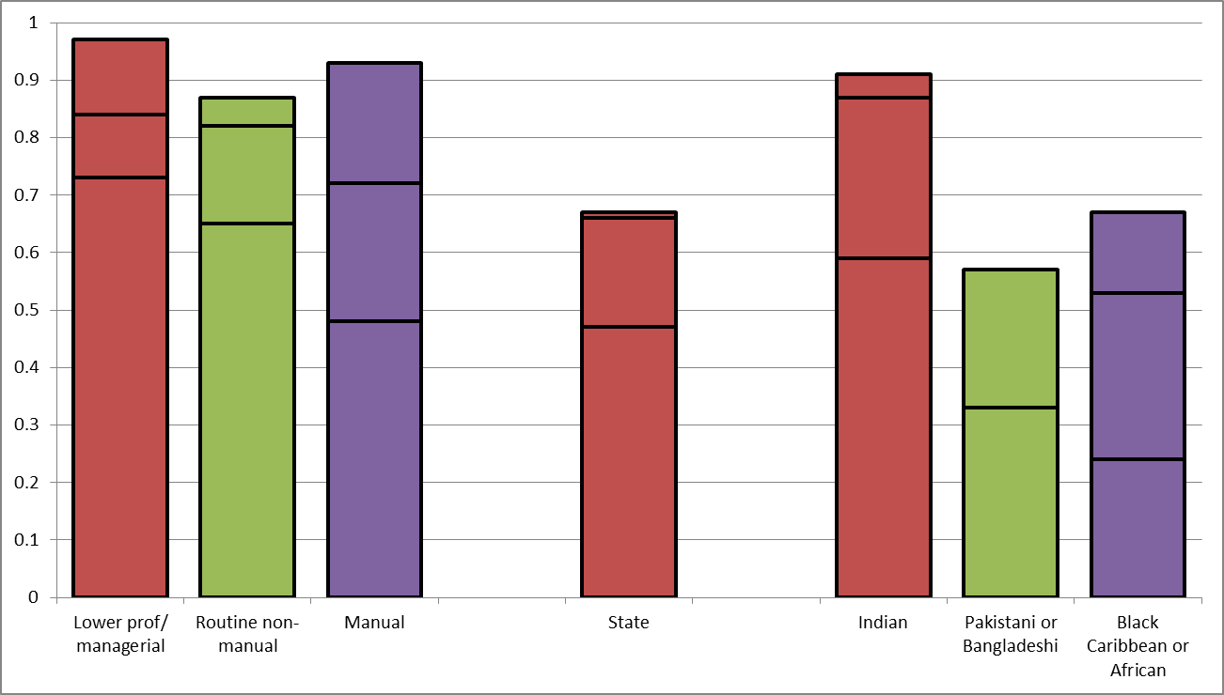
Admission
Model 4 A-level applicants only, specific grades and ‘facilitating subjects’
Odds ratios: offer of admission from a Russell Group university
Model 4 includes controls for sex, mature student status, HE subject area, HE qualification aim, HEI applied to (anonymized), application year, A-level grades and ‘facilitating subjects’ at A-level.
Notes:
Biology, Chemistry, English Literature, Geography, History, Languages, Physics, and Maths

Slide 18
Summary of findings
Access to more prestigious UK universities is far from ‘fair’. After taking social group differences in prior attainment into account:
  Social class differences remain in propensities to apply to Russell Group universities;
  Ethnic differences remain in the chances of admission to Russell Group universities given application;
  And school background differences persist in the likelihood of application and of admission to Russell Group universities.
Patterns of (un)fair access changed little over the period 1996-2006
Counterfactual estimates suggest that, had access been ‘fair’, at least 5,000 more ‘non-traditional’ students might have entered Russell Group universities every year

Slide 19
How fair is access to more prestigious UK universities?
Vikki Boliver
CRESJ seminar
University of York
12th June 2012

